Slide 1
Initializer list
C++ Knowledge Sharing Sessions

Slide 2
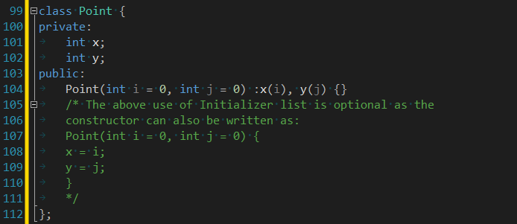
What is it?
Initializer list is used to initialize data members of a class.
The list of members to be initialized is indicated with constructor as a comma separated list followed by a colon.
--SYNTAX EXAMPLE--

Slide 3
Why should we use it?
Isn’t it just a style of coding?
Is it ever absolutely necessary?!
- Yes, sometimes!

Slide 4
Here’s when it is a ‘MUST’
For initialization of non-static constant data members.
For initialization of reference members.
For initialization of member objects which do not have default constructor.
When constructor’s parameter name is same as data member.
For Performance reasons (better coding practice)

Slide 5
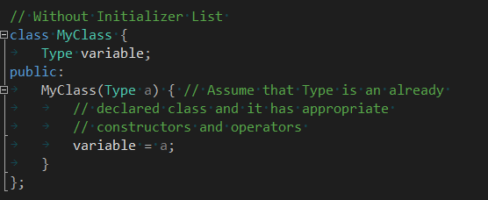
Performance Improvisation
Here compiler follows following steps to create an object of type MyClass without IL
Type’s constructor is called first for “a”.
The assignment operator of “Type” is called inside body of MyClass() constructor to assign
And then finally destructor of “Type” is called for “a” since it goes out of scope.
With the Initializer List, following steps are followed by compiler:
Copy constructor of “Type” class is called to initialize : variable(a). The arguments in initializer list are used to copy construct “variable” directly.
Destructor of “Type” is called for “a” since it goes out of scope.
As we can see from this example if we use assignment inside constructor body there are three function calls: constructor + destructor + one addition assignment operator call. And if we use Initializer List there are only two function calls: copy constructor + destructor call.
In this example, the difference is negligible, but imagine if you will that MyClass’ default constructor did more, such as allocating memory or opening files.

